Slide 1
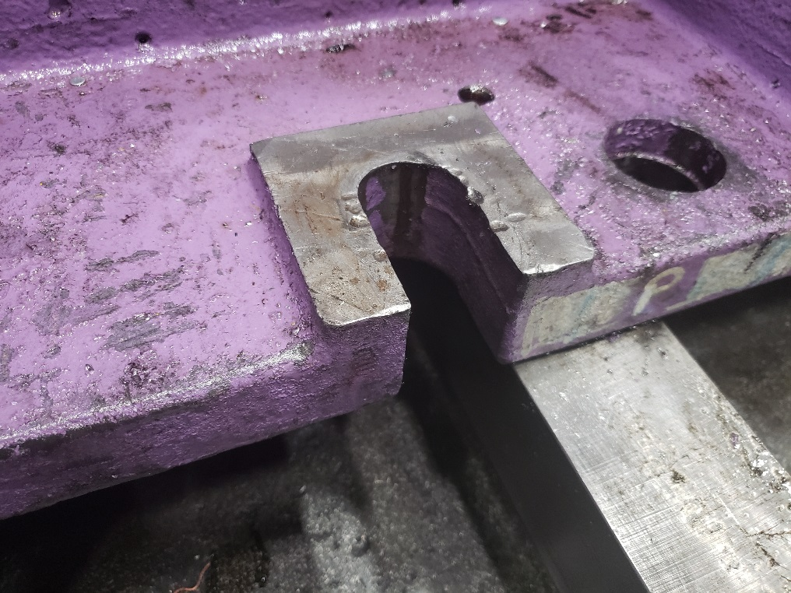
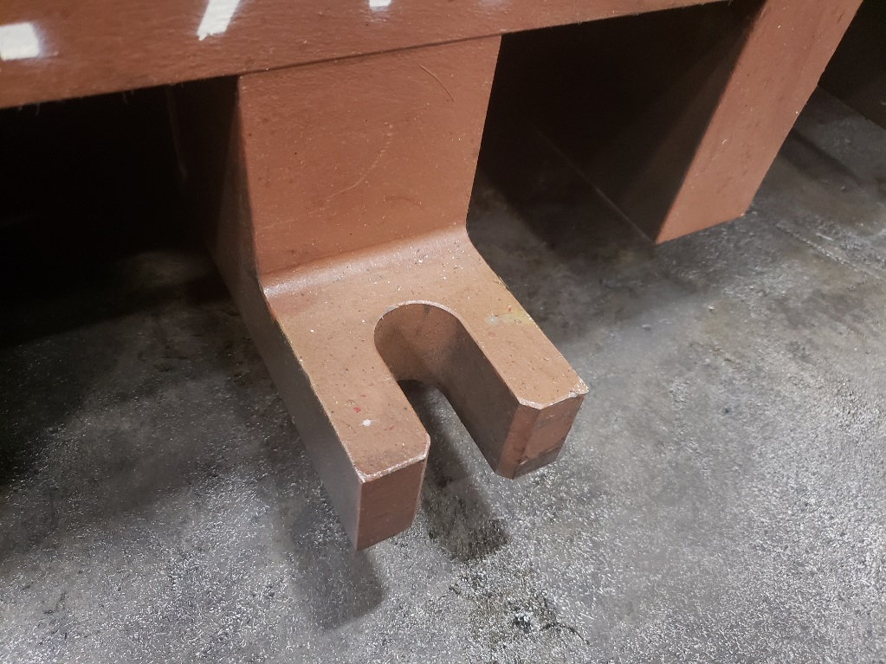
Die Mounting
Slot in either die shoe or parallels. Slots must be 1.125” wide by min of 3” deep

